Slide 1

Basketball Offensive Play Optimisation
DHRUV SRIVASTAVA AND YASH SANGTANI

Slide 2
Problem Statement
01
02
03
During an offensive possession, given an oppo-
nent’s defensive scheme, what is the play scenario
that has the highest probability of success?
What kind of kind of shot has the highest make probability given the situation?
At each point in the game, what is the EPV (Expected Possession Value) of each player. Use it to recommend the the 5 players on the court.
Analyze and classify basketball plays
Focus on offensive shot type to boost chances
Enhance team performance and strategy formulation

Slide 3
LITERATURE SURVEY
Reviewing prior research
Paper | Author(s)
A Method for Using Player Tracking Data in Basketball to Learn Player Skills and Predict Team Performance. | Brian Skinner, Stephen J. Guy
Optimizing the best play in basketball using deep learning | Leili Javadpour, Jessica Blakeslee.
Applying Deep Learning to Basketball Trajectories | Rajiv C. Shah, Rob Romijnders
Classifying NBA Offensive Plays Using Neural Networks | Kuan-Chieh Wang, Richard Zemel
Generating Defensive Plays in Basketball Games | Chieh-Yu Chen, Wenze Lai
Expected Possession Value: An Evaluation Framework for Decision-Making, Strategy, and Execution in Basketball | Ivan C. Jutamulia
“How to Get an Open Shot”: Analyzing Team Movement in Basketball using Tracking Data | Patrick Lucey, Alina Bialkowski,
PREDICTING SHOT MAKING IN BASKETBALL LEARNT FROM ADVERSARIAL MULTIAGENT TRAJECTORIES | Mark Harmon, Patrick Lucey

Slide 4
LITERATURE SURVEY
Reviewing prior research
Paper | Author(s)
Identifying Basketball Plays from Sensor Data; towards a Low-Cost Automatic Extraction of Advanced Statistics | Adria Arbues Sanguesa, Thomas B. Moeslund
Optimizing Offensive Gameplan in the National Basketball Association with Machine Learning | Eamon Mukhopadhyay,
Possession Sketches: Mapping NBA Strategies | AndrewC. Miller, Luke Bornn
Perceived Hotness Affects Behavior of Basketball Players and Coaches | Yigal Attali
Crunch time in the NBA– The effectiveness of different play types in the endgame of close matches in professional basketbal | Jan Christmann, Max Akamphuber
Use of Machine Learning to Automate the Identification of Basketball Strategies Using Whole Team Player Tracking Data | Changjia Tian, Varuna De Silva
Decision making for basketball clutch shots: A data driven approach | Yuval Eppel, Mor Kaspi
AnAnalysis of Sports News in the Era of Big Data- Visual Data News with NBA Coverage as an Exampl | Kai Gao, Li Tang, and Jialin Lu

Slide 5
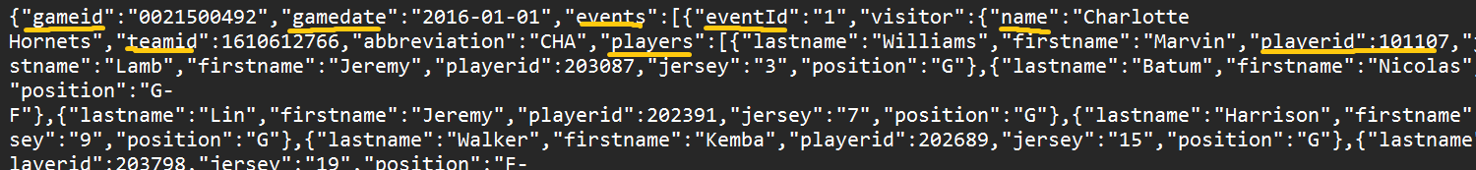
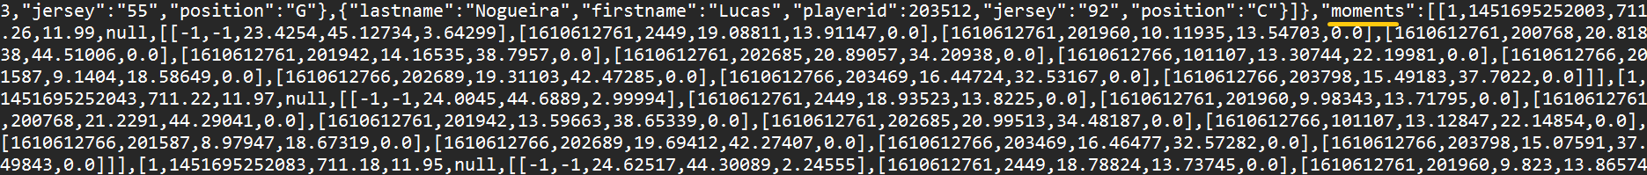
DATASET ANALYSIS
Exploring the SportsVU dataset for basketball plays
Players and the location of the ball are recorded every 0.04 seconds in this JSON data set.
The SportsVU dataset includes every player's details as well as their distinct NBA player ID.
We only have 2015-16 data which was the only year where they made the data public.
Here’s the first moment of the first event. The first number is the quarter. The second number is the time of the event in milliseconds. The third number is the number of seconds left in the quarter (the 1st quarter hasn’t started yet, so 12 * 60 = 720). The fourth number is the number of seconds left on the shot clock.
The final matrix is 11x5 matrix. The first row describes the ball. The first two columns are the teamID and the playerID of the ball (-1 for both because the ball does not belong to a team and is not a player). The 3rd and 4th columns are xy coordinates of the ball. The final column is the height of the ball (z coordinate).
The next 10 rows describe the 10 players on the court. The first 5 players belong to the home team and the last 5 players belong to the visiting team. Each player has his teamID, playerID, xy&z coordinates (although their z coordinates ever change).

Slide 6
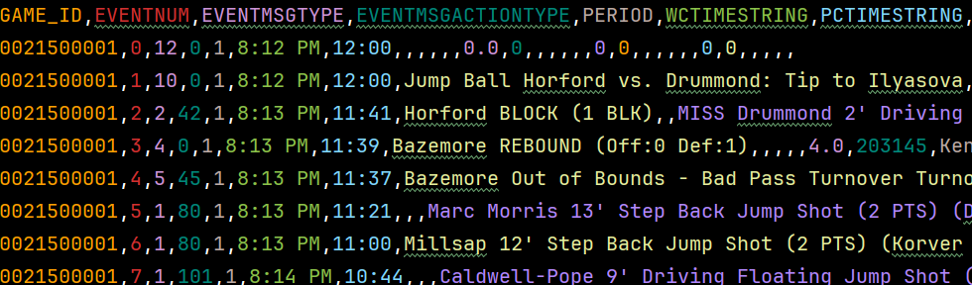
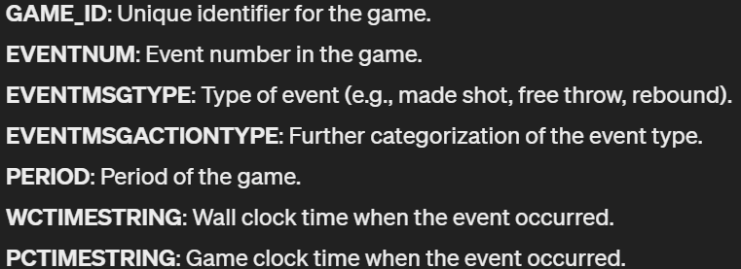
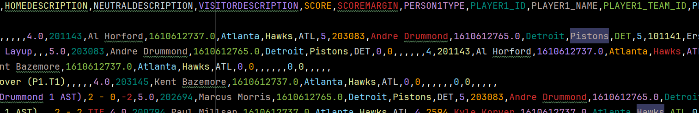
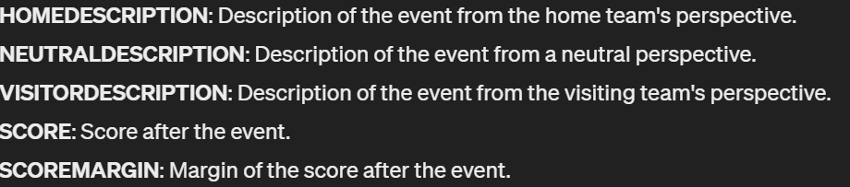
DATASET ANALYSIS
These fields in the pbp (play-by-play) CSV files provide detailed information about each event that occurred during the game.
Was earlier accessible through nba.stats API but now that service is discontinued.
The pbp data complements the SportsVU data by offering a narrative description of events and player involvement, whereas SportsVU data provides more granular tracking data, such as player movement and ball tracking.

Slide 7
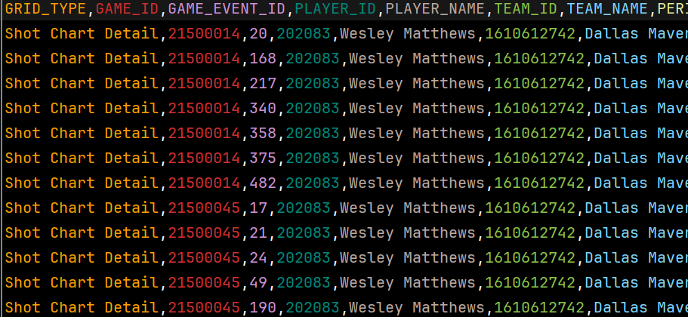
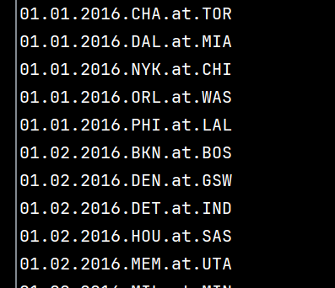
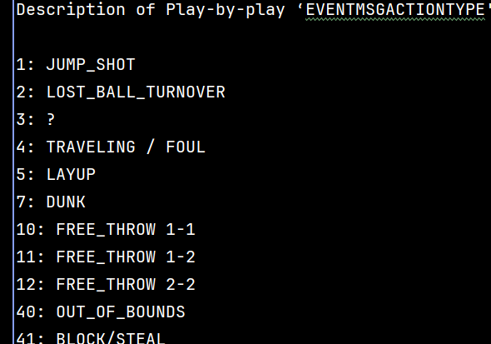
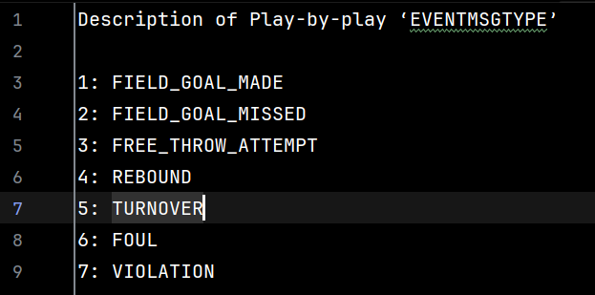
DATASET ANALYSIS
Since the play-by-play data provided to us was 1 big fill with all the games and data catalogued, to improve efficiency we :
Segregated the content according to the corresponding match_id and store in match_id.csv.
Create another csv file with just the shot detail data for every shot taken in that game with the proper action type, event type extracted from the description provided in the play-by-play data.
Scraped the titles of all the games from the log folder, and stored all the action type and event type encodings found in text files for faster indexing.

Slide 8
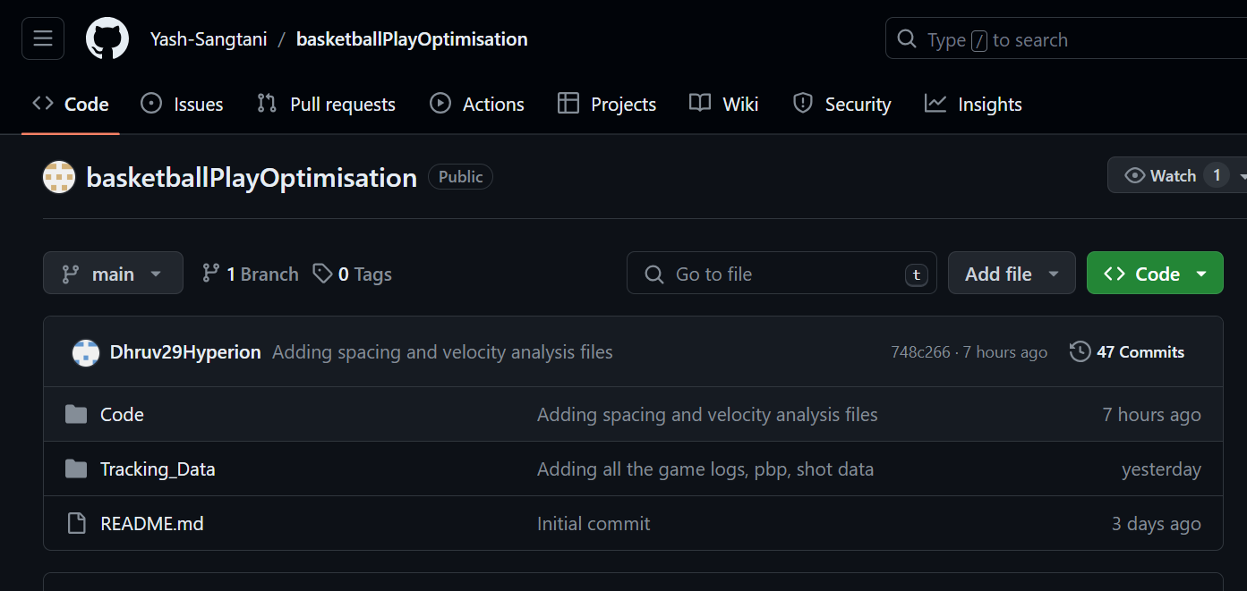
Understanding and Playing with the Data
To understand and learn how to parse through the data to evaluate valuable combined features (such as velocity, spacing, etc), we undertook the project to make a visualizer with certain special features. This helped us understand the capabilities of the dataset in hand and what else do we need moving forward.

Slide 9
Basic Visualizer

Slide 10
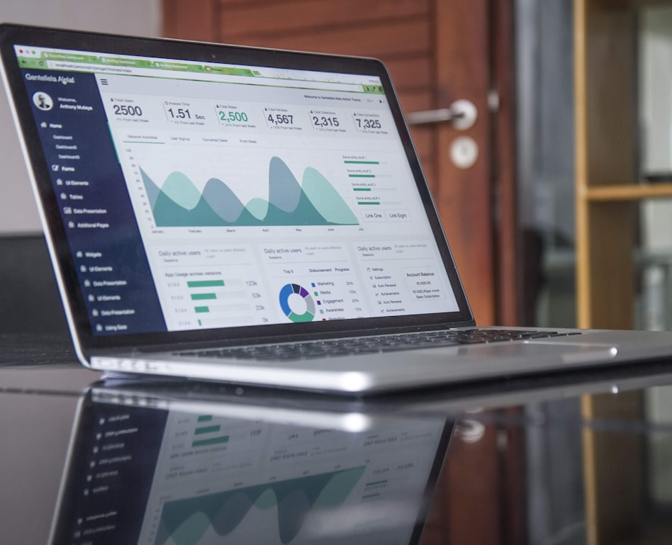

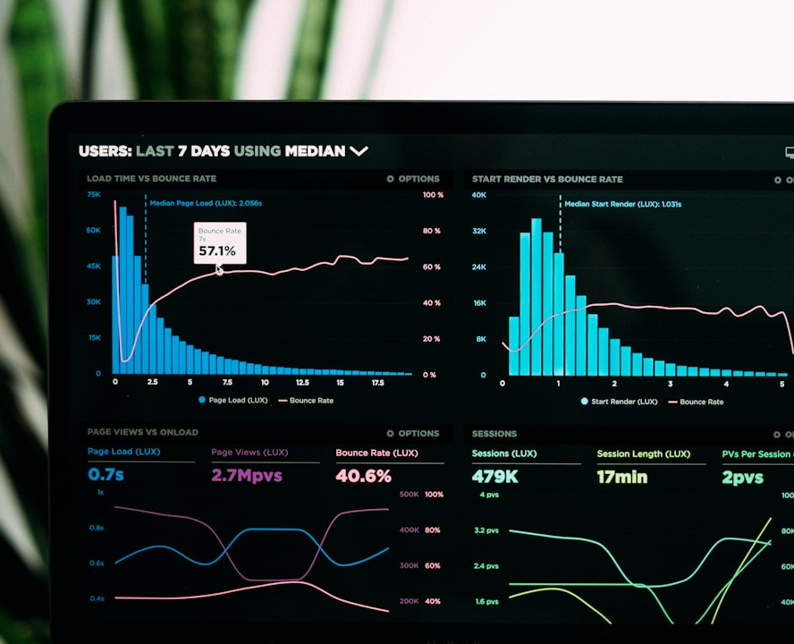
Features Preprocessing
CLEANING DATA
FEATURE ENGINEERING
DIMENSIONALITY REDUCTION
Extracting chunks from large, unreadable JSON data.
Since the data we are working with is the official NBA dataset, there was not much to clean.
Velocity of players
Distance of each player from the ball.
Distance of each player from the basket.
Formation geometry
screen count
We got rid of unwanted column, such as epoch timestamp.

Slide 11
Proposed ML Methodology
Clustering
Second step
Third step
Final step
UNSUPERVISED LEARNING
UNSUPERVISED LEARNING
PHASE 3
PHASE 4
PHASE 5

Slide 12
RESULTS AND ANALYSIS
Yet another idea
Analyzing the classification results and insights
One idea
Another idea
Awesome

Slide 13



Conclusion
SUMMARIZING FINDINGS
FUTURE RESEARCH
CALL TO ACTION
Key insights and discoveries from our research and analysis
Promising avenues for further exploration and investigation
Inspiring the audience to apply the findings to their work

Slide 14

Questions and Discussion
PHONE
+123456789
EMAIL
contact@yourcompany.com
ADDRESS
123 Street
City
Country

Slide 15



